Slide 1
VLSI Implementation of Edge Detection Operation for Iris Images
Batch 1
Presented by :
Biju B [202023]
Godwin N [202037]
Ananthu P Nair [202039]
Dhanush Ben B [202032]
Guided by :
Dr. S. Absa ECE Assistant Professor

Slide 2
Abstract
Edge detection is a fundamental component of image processing, crucial for tasks such as image enhancement, recognition, restoration, and compression. The Sobel algorithm is commonly employed for edge detection, identifying boundaries where the gradient of the image is high. This project focuses on the VLSI implementation of the edge detection operation for iris images. Initially, the RGB image is converted to grayscale using MATLAB-Simulink HDL blocks. The grayscale image is then fed into Xilinx Vivado IDE, where Verilog HDL is utilized to apply the Sobel algorithm, extracting edge pixels. This approach enables efficient edge detection suitable for real-time iris recognition systems, enhancing both accuracy and speed of authentication processes.

Slide 3
Objective
To implement efficient edge detection for iris images using VIVADO IDE and MATLAB-Simulink.

Slide 4
Introduction
Edge detection is crucial in image processing, highlighting sharp changes in image brightness that define object boundaries.
Detecting edges can enhance image quality, reduce data redundancy, and extract essential information efficiently.

Slide 5
Edge detection
Algorithms like Sobel, Canny, or Roberts methods help in recognizing edges based on changes in intensity, gradient, or texture.
Edge detection is important in fields like medical imaging, autonomous driving, and quality control for precise image analysis.
VLSI implementation of Sobel edge detection, proposed by Boo et al. in 1994, enhances edge detection speed and efficiency.

Slide 6
Literature Survey
S/No | Title (Year) | Inference/Methodology | Merits and Demerits
1 | C. Pradabpet et al. (2009) "An efficient filter structure for multiplier-less Sobel edge detection" | The paper focuses on optimizing the Sobel edge detection algorithm by designing a filter structure that eliminates the need for multipliers, aiming to reduce hardware complexity and resource utilization in FPGA-based implementations of edge detection. | Merits: Significant advancement in FPGA-based edge detection by providing a multiplier-less architecture tailored specifically for Sobel edge detection tasks. Demerits: Specifics on the actual performance improvement and resource utilization reduction are not provided.
2 | C. Perra et al. (2005) "Image Blockiness Evaluation Based Sobel Operator" | The paper proposes a method for image blockiness evaluation using the Sobel operator, providing a quantitative measure crucial for evaluating image compression algorithms and video quality. | Merits: Novel application of the Sobel operator for assessing blockiness artifacts in digital images. Demerits: Limited discussion on the application of the proposed method in real-world scenarios.
3 | D. Alghurair, S. S. AI-Rawi. (2013) "Design of Sobel Operator using Field Programmable Gate Array" | The paper focuses on implementing the Sobel operator on FPGA for edge detection in digital images, aiming to achieve high-performance edge detection suitable for real-time applications. | Merits: Contribution to advancing FPGA-based image processing algorithms and their practical implementations. Demerits: Lack of detailed comparison with other existing FPGA-based Sobel operator designs.
4 | Fernando Martinez Vallina, Christian Kohn, and Pallav Joshi. (2012) "Zynq All Programmable SoC Sobel Filter Implementation using the Vivado HLS Tool" | The paper discusses the implementation of a Sobel filter on a Zynq All Programmable SoC platform using Vivado HLS, aiming to achieve efficient edge detection in real-time applications. | Merits: Demonstrates the feasibility of using Zynq SoC devices for implementing complex image processing algorithms such as the Sobel filter. Demerits: Limited discussion on the practicality and scalability of the implementation.

Slide 7
Literature Survey
5 | I.Yasri, N.H.Hamid, V.V.Yap. (2008) "Performance Analysis of FPGA Based Sobel Edge Detection Operator" | The paper evaluates the efficiency of FPGA-based implementations of the Sobel edge detection algorithm, providing insights into the suitability of FPGA technology for edge detection applications. | Merits: Provides insights into the performance characteristics of FPGA-based edge detection systems. Demerits: Limited discussion on the specific FPGA architectures and optimization techniques used in the analysis.
6 | Jamie Schiel, Andrew Bainbridge-Smith. (2015) "Efficient Edge Detection on Low-Cost FPGAs" | The paper discusses methods for optimizing edge detection algorithms for implementation on low-cost FPGAs, aiming to achieve real-time performance while minimizing resource utilization. | Merits: Focuses on making FPGA-based edge detection more accessible for a wide range of applications. Demerits: Limited discussion on the specific low-cost FPGA platforms and their capabilities.
7 | K. Shah. (2013) "Performance analysis of Sobel edge detection filter on GPU using CUDA & OpenGL" | The paper evaluates the performance of Sobel edge detection on GPU platforms using CUDA and OpenGL frameworks, providing insights into the suitability of GPU acceleration for edge detection tasks. | Merits: Provides insights into the potential of GPU technology for real-time image processing applications. Demerits: Limited discussion on the comparison between FPGA-based and GPU-based Sobel edge detection implementations.
8 | K. Wong, A. Chekima, J. Dargham and G. Sainarayanan. (2008) "Palmprint identification using Sobel operator" | The paper introduces a method for palmprint identification based on the Sobel operator, aiming to achieve accurate and reliable biometric authentication. | Merits: Contributes to advancing biometric authentication methods based on image processing techniques. Demerits: Limited discussion on the scalability and robustness of the palmprint identification method.
9 | L. Xue, Z. Rongchun and W. Qing. (2003) "FPGA based Sobel algorithm as vehicle edge detector in VCAS" | The paper presents an FPGA-based algorithm for detecting edges of vehicles in Vehicle Collision Avoidance Systems (VCAS), aiming to provide real-time and reliable detection of vehicle edges. | Merits: Contributes to the advancement of safety systems in vehicular applications. Demerits: Limited discussion on the performance and accuracy of the vehicle edge detection algorithm in real-world scenarios.

Slide 8
Literature Survey
10 | M Boo, E Antelo, and JD Bruguera. (1994) "VLSI implementation of an edge detector based on Sobel operator" | The paper presents a VLSI implementation of an edge detector based on the Sobel operator, aiming to achieve high-speed and efficient edge detection in digital images. | Merits: Early contribution to VLSI-based edge detection algorithms. Demerits: Limited discussion on the specific VLSI architectures and optimization techniques used in the implementation.
11 | N. Kazakova, M. Margala and N. Durdle. (2004) "Sobel edge detection Processor for a real-time volume rendering system" | The paper introduces a Sobel edge detection processor for real-time volume rendering systems, aiming to improve the visualization of volumetric data by highlighting edges. | Merits: Contributes to enhancing the visualization of volumetric data in real-time systems. Demerits: Limited discussion on the computational efficiency and scalability of the edge detection processor.
12 | N. Prathyusha and A. Balaji Nehru. (2013) "A high-speed ASIC design for Sobel edge detection using FPGA" | The paper presents a high-speed ASIC design for Sobel edge detection using FPGA, aiming to achieve efficient edge detection suitable for real-time applications. | Merits: Focuses on achieving high-speed edge detection using FPGA-based ASIC design. Demerits: Limited discussion on the specific ASIC design techniques and their performance compared to traditional FPGA-based implementations.
13 | Nick Kanopoulos et al. (1988) "Design of an Image Edge Detection Filter using the Sobel Operator" | The paper presents a design of an image edge detection filter using the Sobel operator, aiming to achieve accurate and reliable edge detection in digital images. | Merits: Early contribution to image edge detection using the Sobel operator. Demerits: Limited discussion on the computational efficiency and robustness of the edge detection filter.
14 | O. R. Vincent, O. Folorunso. (2009) "A Descriptive Algorithm for Sobel Image Edge Detection" | The paper introduces a descriptive algorithm for Sobel image edge detection, providing a detailed explanation of the algorithm's implementation and operation. | Merits: Provides a detailed description of the Sobel image edge detection algorithm. Demerits: Limited discussion on the algorithm's performance and applicability in real-world scenarios.

Slide 9
Literature Survey
15 | Pujare, A., Sawant, P., Sharma, H., & Pichhode, K. (2020). "Hardware Implementation of Sobel Edge Detection Algorithm" | The paper discusses the hardware implementation of the Sobel edge detection algorithm, aiming to achieve efficient edge detection suitable for real-time applications. | Merits: Recent work on hardware implementation of the Sobel edge detection algorithm. Demerits: Limited discussion on the specific hardware platform and implementation techniques used in the study.
16 | R. Rosas, A. de Luca and F. Santillan. (2005) "SIMD architecture for image segmentation using Sobel operators implemented in FPGA technology" | The paper presents a SIMD architecture for image segmentation using Sobel operators implemented in FPGA technology, aiming to improve the efficiency and performance of image segmentation algorithms. | Merits: Focuses on improving the efficiency of image segmentation using FPGA technology. Demerits: Limited discussion on the scalability and practicality of the SIMD architecture in real-world applications.
17 | Rajesh Mehra and Rupinder Verma. (2012) "Area Efficient FPGA Implementation of Sobel Edge Detector for Image Processing Applications" | The paper presents an area-efficient FPGA implementation of the Sobel edge detector for image processing applications, aiming to achieve high-performance edge detection with minimal resource utilization. | Merits: Focuses on achieving high-performance edge detection with minimal resource utilization. Demerits: Limited discussion on the specific area-efficient techniques and their performance compared to traditional FPGA-based implementations.
18 | S. Chivapreecha et al. (2004) "Hardware implementation of Sobel-edge detection distributed arithmetic digital filter" | The paper presents a hardware implementation of a Sobel-edge detection distributed arithmetic digital filter, aiming to achieve efficient edge detection suitable for real-time applications. | Merits: Focuses on achieving efficient edge detection using distributed arithmetic digital filter. Demerits: Limited discussion on the specific implementation details and their performance compared to traditional FPGA-based implementations.
19 | S. Jin, W. Kim and J. Jeong. (2008) "Fine directional de-interlacing algorithm using modified Sobel operation" | The paper introduces a fine directional de-interlacing algorithm using a modified Sobel operation, aiming to improve the quality of de-interlacing in digital images. | Merits: Focuses on improving the quality of de-interlacing using a modified Sobel operation. Demerits: Limited discussion on the specific modifications to the Sobel operation and their performance compared to traditional de-interlacing algorithms.

Slide 10
Literature Survey
20 | SantanuHalder et al. (2012) "A fast FPGA based architecture for Sobel edge detection" | Presents a fast FPGA-based architecture for Sobel edge detection, focusing on high-speed and efficient edge detection for real-time applications. | Merits: Focuses on achieving high-speed edge detection using FPGA technology. Demerits: Limited discussion on the specific FPGA architecture and its performance compared to traditional FPGA-based implementations.
21 | T. A. Abbasi and M. U. Abbasi. (2007) "A novel FPGA based architecture for Sobel edge detection operator" | Introduces a novel FPGA-based architecture for the Sobel edge detection operator, aiming for efficient edge detection suitable for real-time applications. | Merits: Focuses on achieving efficient edge detection using a novel FPGA architecture. Demerits: Limited discussion on the novelty and practicality of the FPGA architecture in real-world applications.
22 | Tanvir A Abbasi, MohdAbbasi. (2007) "A proposed FPGA based architecture for Sobel edge detection operator" | Proposes an FPGA-based architecture for the Sobel edge detection operator, aiming for efficient edge detection suitable for real-time applications. | Merits: Focuses on proposing an FPGA-based architecture for efficient edge detection. Demerits: Limited discussion on the specific architecture and its performance compared to traditional FPGA-based implementations.
23 | Vanishree, K.V. Ramana Reddy. (2013) "Implementation of Pipelined Sobel Edge Detection Algorithm on FPGA for High Speed Applications" | Presents an implementation of a pipelined Sobel edge detection algorithm on FPGA for high-speed applications, aiming for efficient edge detection suitable for real-time applications. | Merits: Focuses on achieving high-speed edge detection using pipelined architecture on FPGA. Demerits: Limited discussion on the specific pipelined architecture and its performance compared to traditional FPGA-based implementations.
24 | Z. Jin and N. Passos. (2002) "Predicting conditional branch outcomes on a Sobel edge detecting filter" | Presents a method for predicting conditional branch outcomes on a Sobel edge detecting filter, aiming to improve the efficiency and performance of edge detection algorithms. | Merits: Focuses on improving the efficiency of edge detection algorithms using branch prediction techniques. Demerits: Limited discussion on the specific branch prediction techniques and their performance compared to traditional edge detection algorithms.
25 | Zahraa Elhassan et al. (2010) "Hardware Implementation of an Optimized Processor Architecture for Sobel Image Edge Detection Operator" | Discusses the hardware implementation of an optimized processor architecture for the Sobel image edge detection operator, aiming for efficient edge detection suitable for real-time applications. | Merits: Focuses on achieving efficient edge detection using an optimized processor architecture. Demerits: Limited discussion on the optimization techniques and their performance compared to traditional FPGA-based implementations.

Slide 11
Summary Of Literature Review
The literature review highlights the significance of edge detection in image processing, particularly using the Sobel operator.
Various studies have proposed efficient hardware implementations of the Sobel edge detection algorithm, focusing on FPGA and ASIC designs.
These implementations offer high-speed and real-time edge detection suitable for applications like image enhancement and recognition.
Furthermore, the literature discusses the application of edge detection in real-world scenarios, such as palmprint identification and vehicle edge detection in video content analysis systems.
These applications demonstrate the versatility and importance of edge detection algorithms in various fields.

Slide 12


Sobel Operator
The process is based on convolving the image with a pair of 3x3 kernels to calculate the approximate gradient of the image intensity in the horizontal and vertical directions. The gradient magnitude and direction are then used to identify edges in the image.
$$\left[\begin{matrix}−1 & 0 & 1 \\ −2 & 0 & 2 \\ −1 & 0 & 1\end{matrix}\right]$$
$$\left[\begin{matrix}−1 & −2 & −1 \\ 0 & 0 & 0 \\ 1 & 2 & 1\end{matrix}\right]$$
Sobel_x =
Sobel_y =
Gradient Magnitude= √( Sobel_x * Image)² + (Sobel_y * Image)²

Slide 13
Block Diagram
Input RGB Image
RGB to Grayscale
Image Enhancement
Sobel X and Y Modules
Output Edge Image
Thresholding Image
Gradient Magnitude

Slide 14
Flow Diagram
RGB Iris Image
Vitis Model to convert blocks into code
Grayscale using Simulink HDL blocks
Pixels to Array format using Matlab
Input the Grayscaled image in Vivado
Sobel X and Y Modules
Gradient Magnitude in verilog
Thresholding Image
Run Synthesis
Output Edge Image

Slide 15
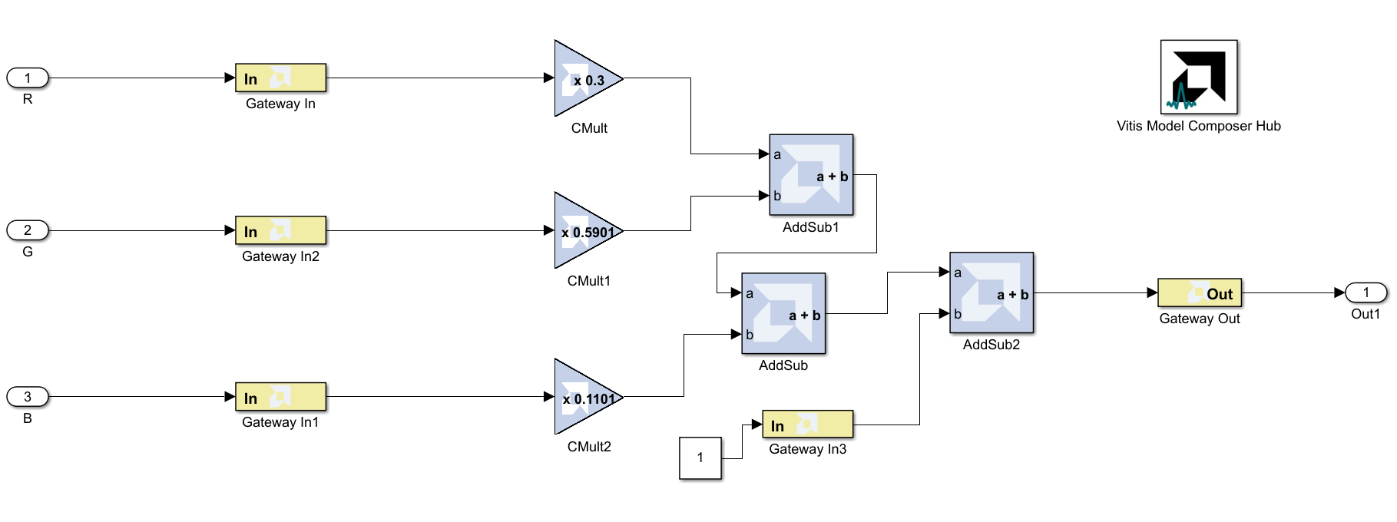
Implementation

Slide 16

Implementation

Slide 17
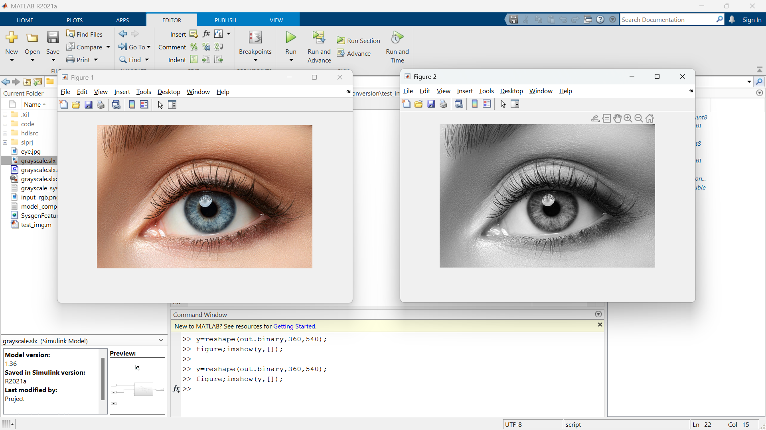
Result

Slide 18
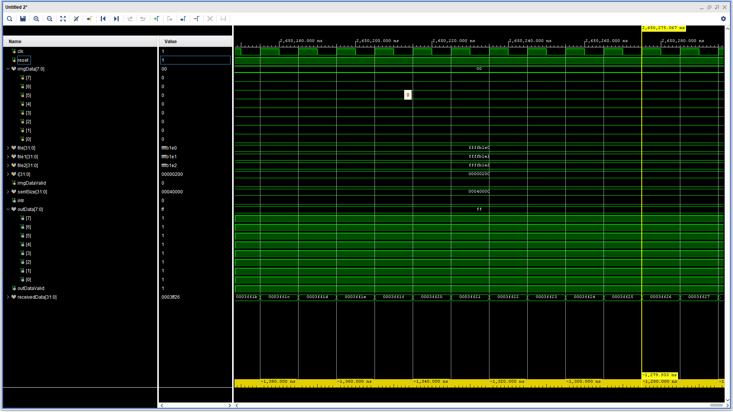
Implementation

Slide 19
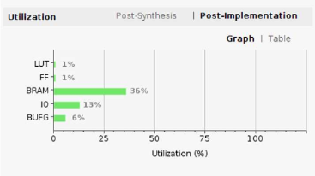
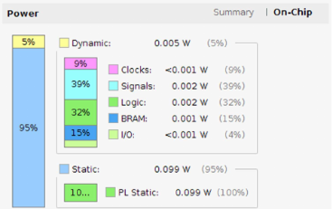
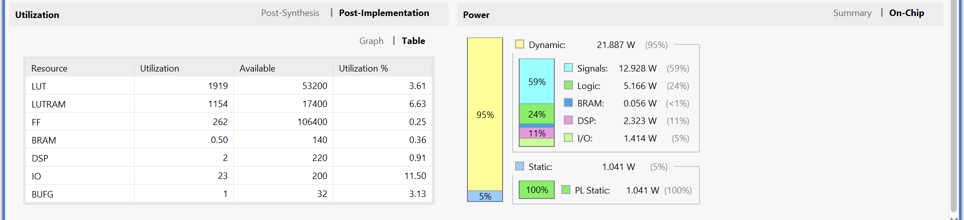
Graph
https://doi.org/10.1051/itmconf/20203203051

Slide 20
Table
Resource | Hardware Implementation of Sobel Edge Detection Algorithm [15] | Proposed System
LUT | 1% | 3.61%
FF | 1% | 0.25%
BRAM | 36% | 0.36%
DSP | - | 0.91%
IO | 13% | 11.50%
BUFIO/BUFG | 6% | 3.31%

Slide 21
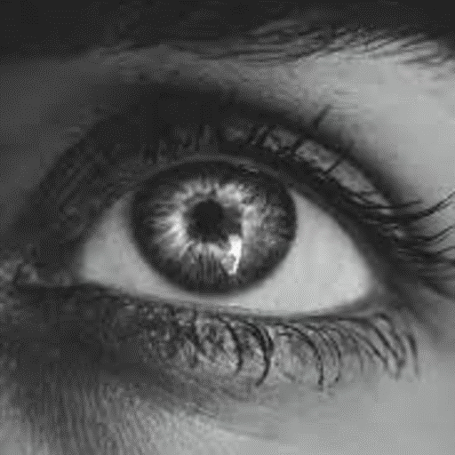
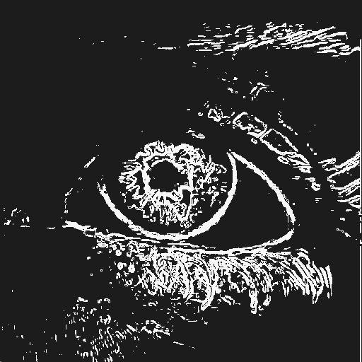
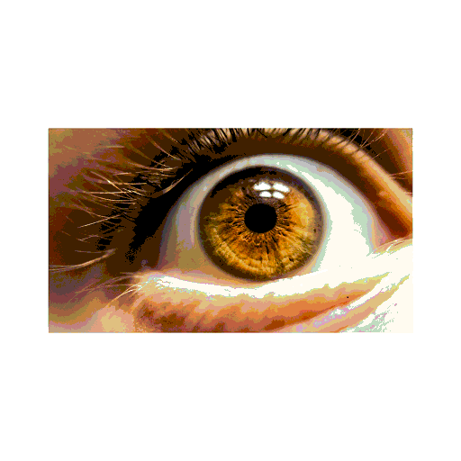
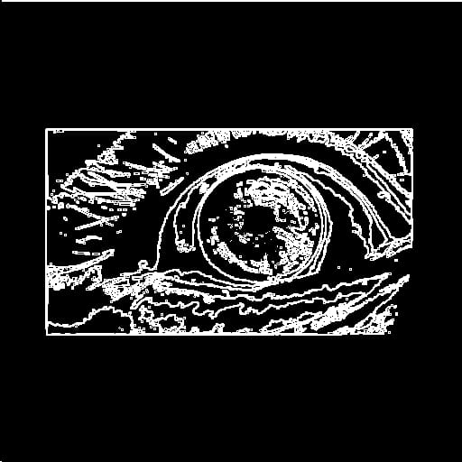
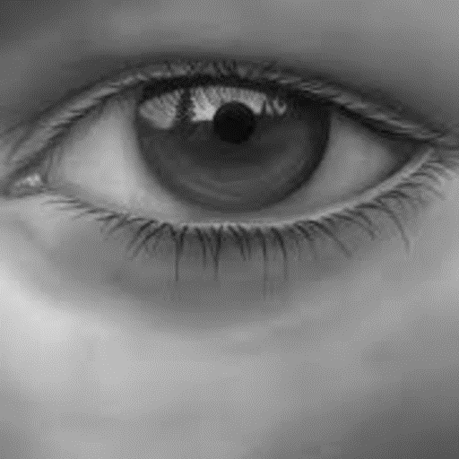
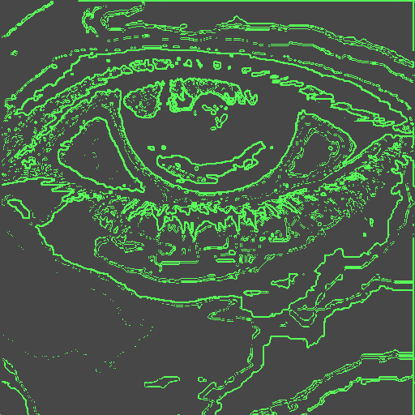
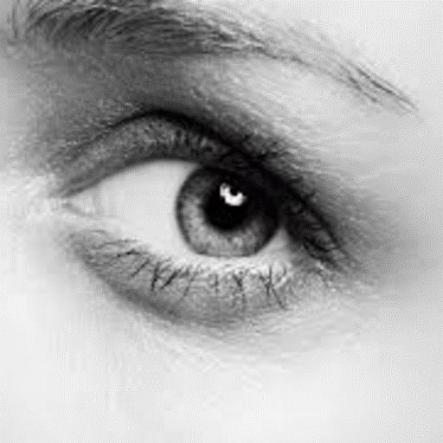
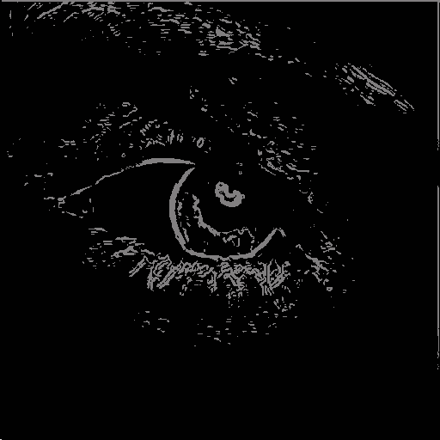
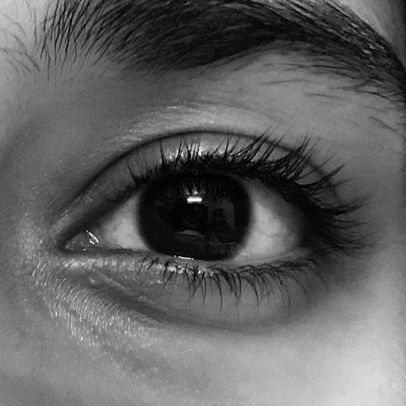
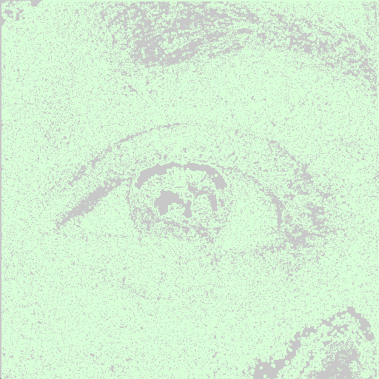
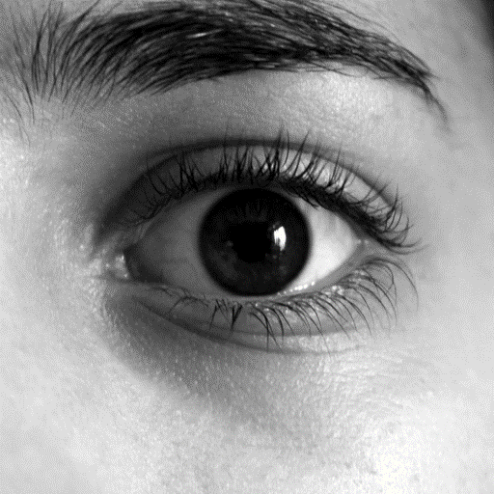
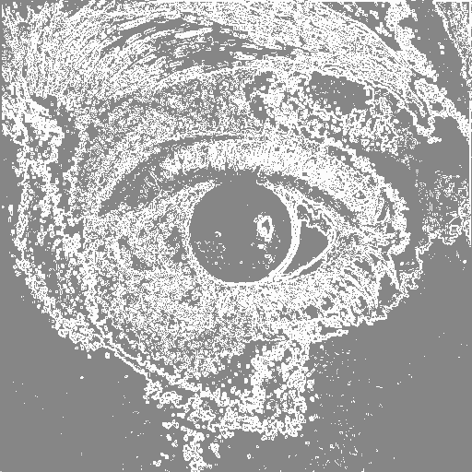
Results

Slide 22
Conclusion
The Sobel edge detection algorithm is implemented by the Zynq UltraScale+ MPSoCs target device using Xilinx vivado IDE platform.
The Execution time of 1000ns is obtained by simulating the input image of resolution 512x512.
The advantage of implementing edge detection using FPGA is for parallel computation speed.

Slide 23
References
[1] C. Pradabpet et al. (2009) "An efficient filter structure for multiplier-less Sobel edge detection," in Proceedings of the IEEE International Conference on Signal Processing Systems (ICSPS), pp. 378-382.
[2] C.Perra et al. (2005) "Image Blockiness Evaluation Based Sobel Operator," EURASIP Journal on Applied Signal Processing, vol. 2005, no. 16, pp. 2566-2579.
[3] D. Alghurair, S. S. AI-Rawi. (2013) "Design of Sobel Operator using Field Programmable Gate Array," International Journal of Computer Applications, vol. 68, no. 15, pp. 1-5.
[4] Fernando Martinez Vallina, Christian Kohn, and Pallav Joshi. (2012) "Zynq All Programmable SoC Sobel Filter Implementation using the Vivado HLS Tool," in Proceedings of the International Conference on Field-Programmable Technology (FPT), pp. 143-146.
[5] I.Yasri, N.H.Hamid, V.V.Yap. (2008) "Performance Analysis of FPGA Based Sobel Edge Detection Operator," International Journal of Computer Science and Network Security, vol. 8, no. 12, pp. 120-125.

Slide 24
References
[6] Jamie Schiel, Andrew Bainbridge-Smith. (2015) "Efficient Edge Detection on Low-Cost FPGAs," in Proceedings of the IEEE International Conference on Field-Programmable Technology (FPT), pp. 1-6.
[7] K. Shah. (2013) "Performance analysis of Sobel edge detection filter on GPU using CUDA & OpenGL," International Journal of Scientific & Engineering Research, vol. 4, no. 6, pp. 1146-1150. [8] K. Wong, A. Chekima, J. Dargham and G. Sainarayanan. (2008) "Palmprint identification using Sobel operator," Pattern Recognition, vol. 41, no. 1, pp. 118-126.
[9] L. Xue, Z. Rongchun and W. Qing. (2003) "FPGA based Sobel algorithm as vehicle edge detector in VCAS," in Proceedings of the IEEE International Conference on Vehicular Electronics and Safety (ICVES), pp. 235-239.
[10] M Boo, E Antelo, and JD Bruguera. (1994) "VLSI implementation of an edge detector based on Sobel operator," IEEE Transactions on Circuits and Systems II: Analog and Digital Signal Processing, vol. 41, no. 11, pp. 730-734.

Slide 25
References
[11] N. Kazakova, M. Margala and N. Durdle. (2004) "Sobel edge detection Processor for a real-time volume rendering system," in Proceedings of the IEEE Symposium on Field-Programmable Custom Computing Machines (FCCM), pp. 310-311.
[12] N. Prathyusha and A. Balaji Nehru. (2013) "A high-speed ASIC design for Sobel edge detection using FPGA," in Proceedings of the International Conference on Electronics, Communication and Aerospace Technology (ICECA), pp. 345-349.
[13] Nick Kanopoulos et al. (1988) "Design of an Image Edge Detection Filter using the Sobel Operator," IEEE Journal of Solid-State Circuits, vol. 23, no. 2, pp. 358-367.
[14] O. R. Vincent, O. Folorunso. (2009) "A Descriptive Algorithm for Sobel Image Edge Detection," International Journal of Computer Science and Network Security, vol. 9, no. 7, pp. 160-165.
[15] Pujare, A., Sawant, P., Sharma, H., & Pichhode, K. (2020). Hardware Implementation of Sobel Edge Detection Algorithm. ITM Web of Conferences, 32, 03051.

Slide 26
References
[16] R. Rosas, A. de Luca and F. Santillan. (2005) "SIMD architecture for image segmentation using Sobel operators implemented in FPGA technology," in Proceedings of the IEEE International Conference on Field-Programmable Technology (FPT), pp. 333-336.
[17] Rajesh Mehra and Rupinder Verma. (2012) "Area Efficient FPGA Implementation of Sobel Edge Detector for Image Processing Applications," International Journal of Computer Applications, vol. 56, no. 14, pp. 22-26.
[18] S. Chivapreecha et al. (2004) "Hardware implementation of Sobel-edge detection distributed arithmetic digital filter," in Proceedings of the IEEE International Symposium on Circuits and Systems (ISCAS), pp. 609-612.
[19] S. Jin, W. Kim and J. Jeong. (2008) "Fine directional de-interlacing algorithm using modified Sobel operation," in Proceedings of the International Conference on Image Processing (ICIP), pp. 280-283.
[20] SantanuHalder et al. (2012) "A fast FPGA based architecture for Sobel edge detection," International Journal of VLSI design & Communication Systems (VLSICS), vol. 3, no. 2, pp. 203-214.

Slide 27
References
[21] T. A. Abbasi and M. U. Abbasi. (2007) "A novel FPGA based architecture for Sobel edge detection operator," International Journal of Computer Science and Network Security, vol. 7, no. 4, pp. 319-323.
[22] Tanvir A Abbasi, MohdAbbasi. (2007) "A proposed FPGA based architecture for Sobel edge detection operator," International Journal of Computer Science and Network Security, vol. 7, no. 8, pp. 186-190.
[23] Vanishree, K.V. Ramana Reddy. (2013) "Implementation of Pipelined Sobel Edge Detection Algorithm on FPGA for High Speed Applications," in Proceedings of the International Conference on Electronics, Communication and Aerospace Technology (ICECA), pp. 124-128.
[24] Z. Jin and N. Passos. (2002) "Predicting conditional branch outcomes on a Sobel edge detecting filter," in Proceedings of the International Conference on Computer Design (ICCD), pp. 90-95.
[25] Zahraa Elhassan et al. (2010) "Hardware Implementation of an Optimized Processor Architecture for Sobel Image Edge Detection Operator," in Proceedings of the IEEE International Conference on Field-Programmable Custom Computing Machines (FCCM), pp. 61-64.

Slide 28
THANK YOU

